Slide 1
Autoresonance phenomenon of wave-electron interaction

Slide 2
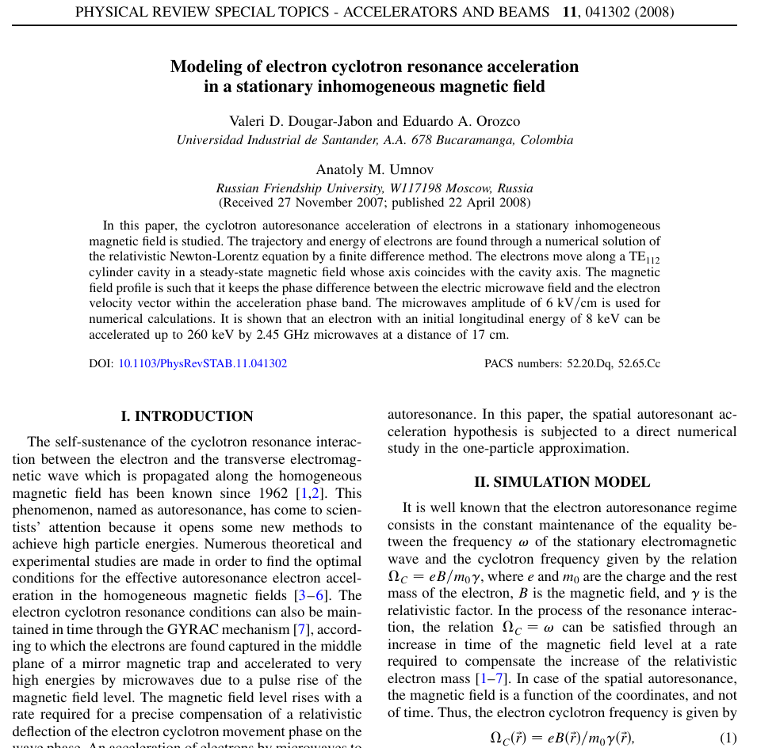

Slide 3
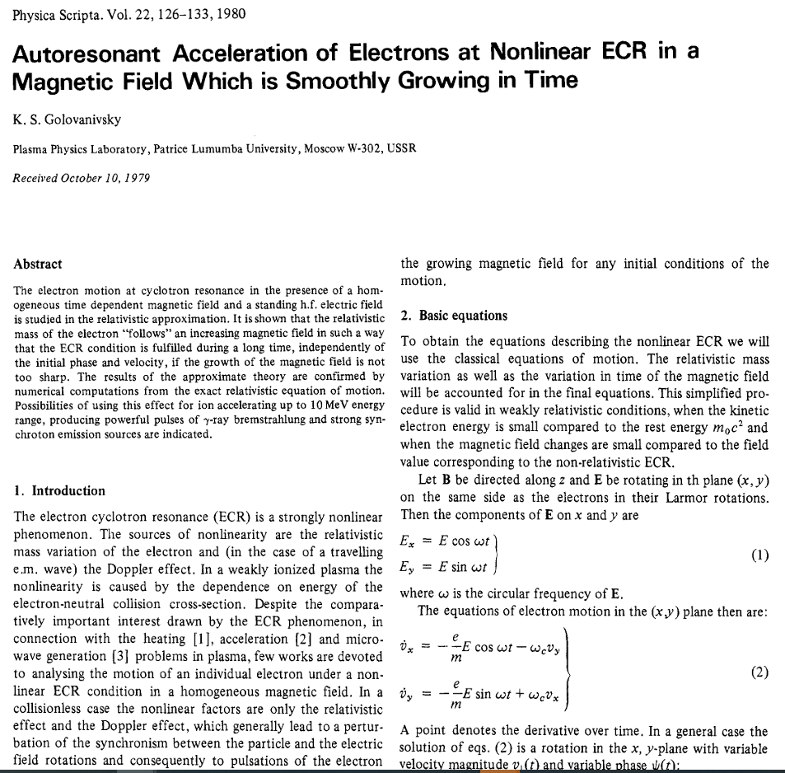

Slide 4
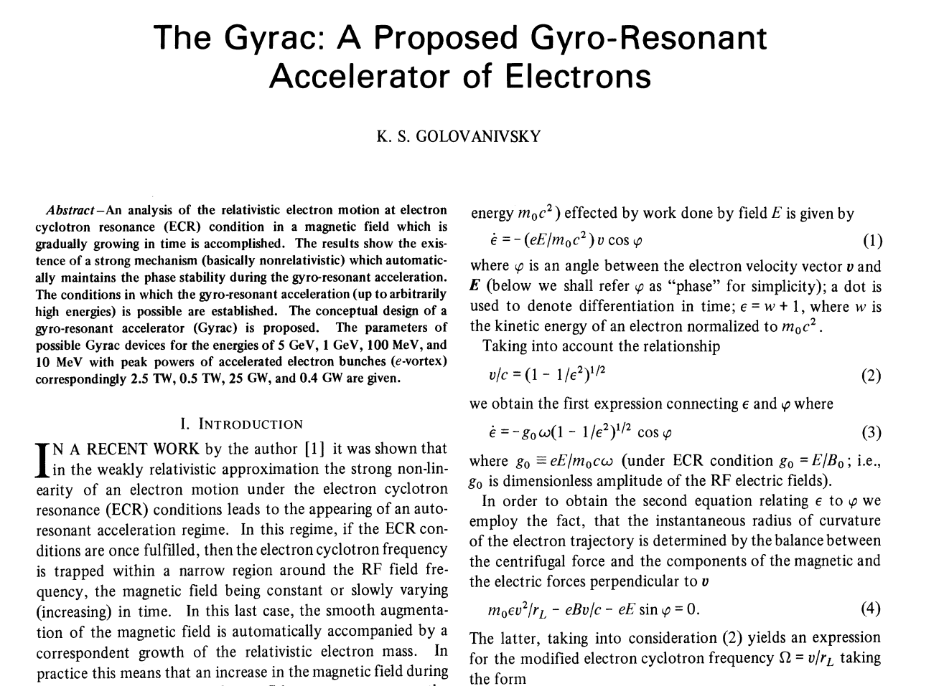
GYRAC mechanism
Obtaining an analytic solution of (7) is a hopeless exercise

Slide 5
Autoresonance ,acceleration:
betatron acceleration
A crucial component of betatron acceleration is a changing magnetic field.
Pondermotive force

